Slide 1
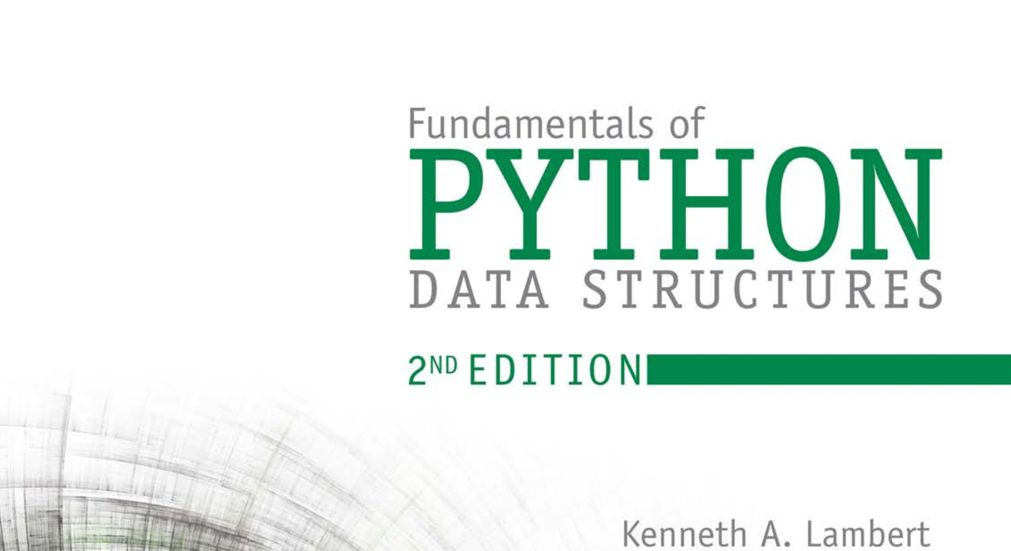
Database Systems: Design, Implementation, and Management 14th Edition
Chapter 1
Database Systems

Slide 2


National Economics University Faculty of Data Science & Artificial Intelligence
DATA STRUCTURES AND ALGORITHMS: COLLECTIONS, ARRAYS, AND Linked Structures
Instructor: Duc Minh Vu (FDA – SLSCM Lab)
Email: minhvd [at] neu.edu.vn
12/19/2024
DATA STRUCTURES AND ALGORITHMS
2

Slide 3
Learning Objectives
Recognize different categories of collections and the operations on them
Understand the difference between an abstract data type and the concrete data structures used to implement it
Perform basic operations on arrays, such as insertions and removals of items
Resize an array when it becomes too small or too large
Describe the space/time trade-offs for users of arrays
Perform basic operations, such as traversals, insertions, and removals, on linked structures
Explain the space/time trade-offs of arrays and linked structures in terms of the memory models that underlie these data structures

Slide 4
Reading
Theory
Array Data Structure – GeeksforGeeks
Linked List Data Structure – GeeksforGeeks
Practice:
Practice | GeeksforGeeks | A computer science portal for geeks
Problems – LeetCode (Array)
Problems – LeetCode (Linked List)

Slide 5
Introduction
Explore several frequently used classes called collections.
Collections all have the same fundamental purpose—they help programmers organize data in programs effectively.
Collections can be viewed from two perspectives. Users or clients of collections are concerned with what they do in various applications.
Developers or implementers of collections are concerned with how they can best perform as general-purpose resources.
Overview of different types of collections from the perspective of the users of those collections, and also introduce two data structures—arrays and linked structures— commonly used to implement collections

Slide 6
13.1 Overview of Collections

Slide 7
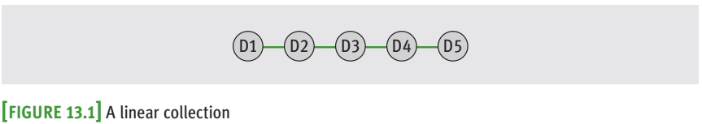
13.1.1 Linear Collections
The items in a linear collection are ordered by position.
Each item except the first has a unique predecessor, and each item except the last has a unique successor.
Everyday examples of linear collections are grocery lists, stacks of dinner plates, and a line of customers waiting at a bank.

Slide 8
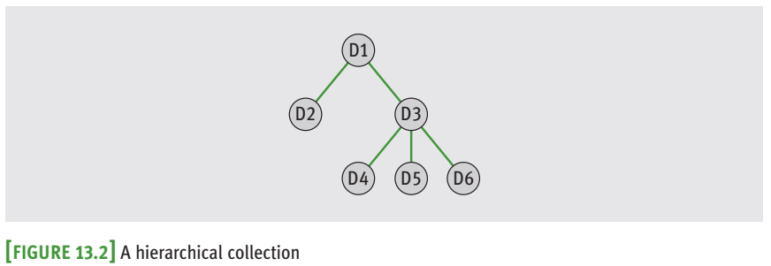
13.1.2 Hierarchical Collections
Data items in hierarchical collections are ordered in a structure reminiscent of an upside-down tree.
Each data item except the one at the top has just one predecessor, its parent, but potentially many successors, called its children.
A file directory system, a company’s organizational tree, and a book’s table of contents are examples of hierarchical collections.

Slide 9
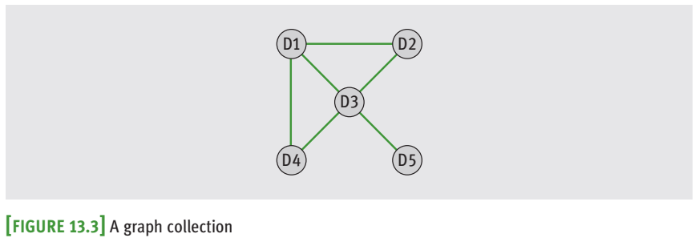
13.1.3 Graph Collections
A graph collection, also called a graph, is a collection in which each data item can have many predecessors and many successors.
Examples of graphs are maps of airline routes between cities and electrical wiring diagrams for buildings.

Slide 10
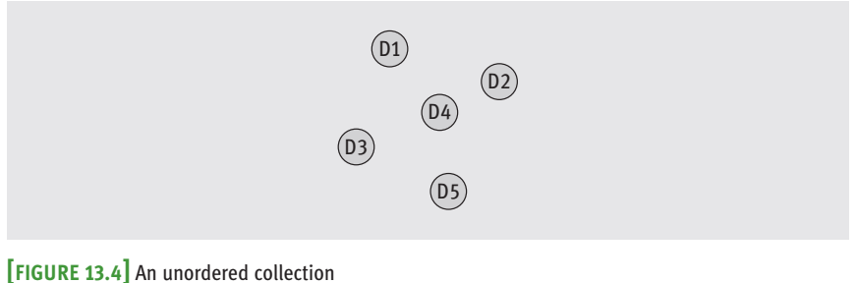
13.1.4 Unordered Collections
items in an unordered collection are not in any particular order, and one cannot meaningfully speak of an item’s predecessor or successor.
A bag of marbles is an example of an unordered collection

Slide 11
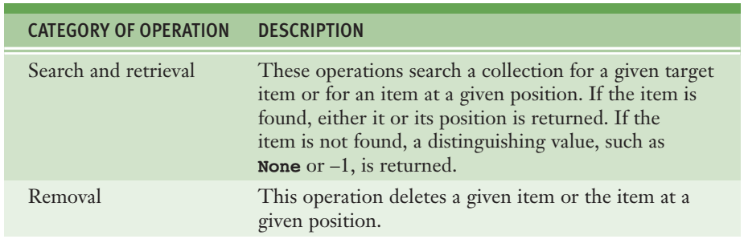
13.1.5 Operations on Collections

Slide 12
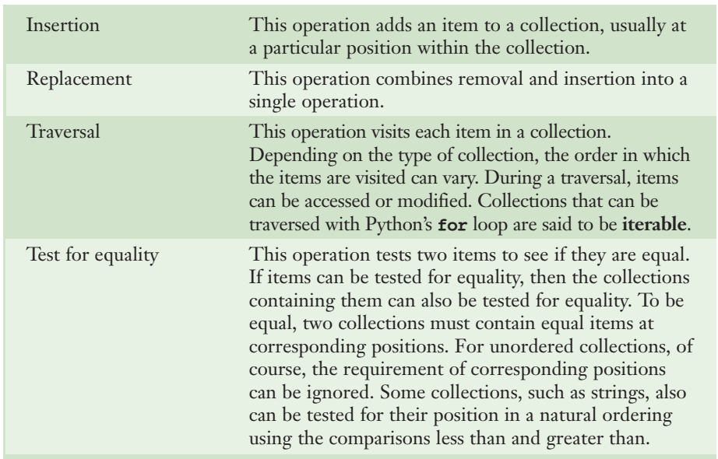
13.1.5 Operations on Collections

Slide 13
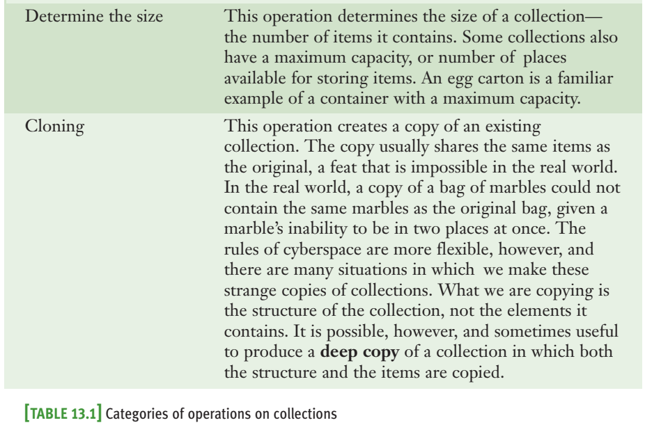
13.1.5 Operations on Collections

Slide 14
13.1.6 Abstraction and Abstract Data Types
User’s perspective: a collection is an abstraction, and for this reason, in computer science, collections are called abstract data types (ADTs).
The user of an ADT is concerned only with learning its interface, or the set of operations that objects of that type recognize.
Developers of collections are concerned with implementing a collection’s behavior in the most efficient manner possible, with the goal of providing the best performance to users of the collections

Slide 15
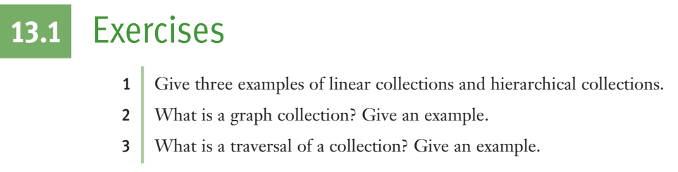

Slide 16
13.2 Data Structures for Implementing Collections: Arrays

Slide 17
13.2.1 The Array Data Structure
An array represents a sequence of items that can be accessed or replaced at given index positions.
The underlying data structure of a Python list is an array
The length or capacity of an array is fixed when it is created

Slide 18
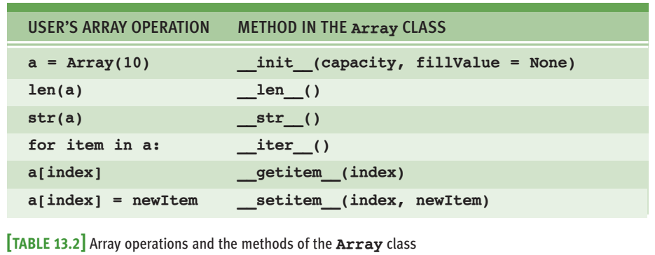

Slide 19
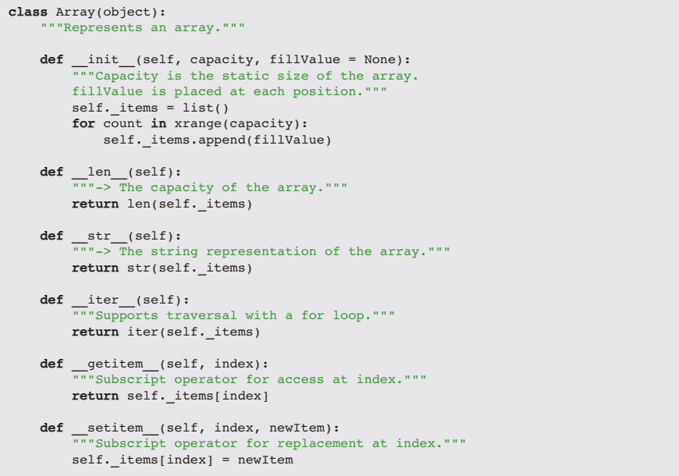

Slide 20
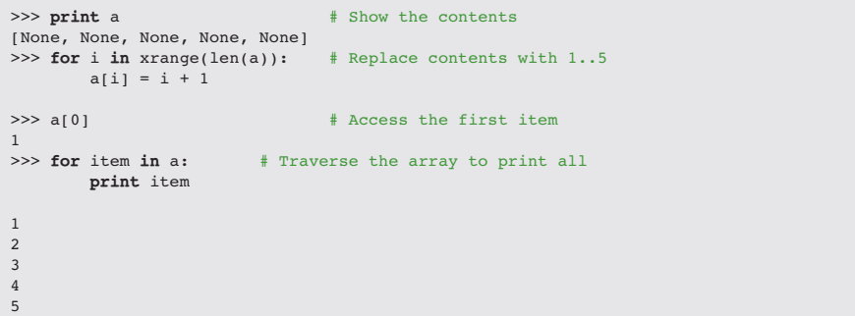

Slide 21
13.3 Operations on Arrays

Slide 22
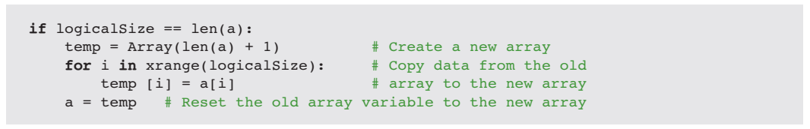
13.3.1 Increasing the Size of an Array
When a new item is about to be inserted and the array’s logical size equals its physical size, it is time to increase the size of the array.
The resizing process consists of three steps:
1 Create a new, larger array.
2 Copy the data from the old array to the new array.
3 Reset the old array variable to the new array object.

Slide 23
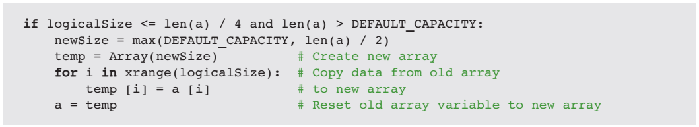
13.3.2 Decreasing the Size of an Array
When the logical size of an array shrinks, cells go to waste.
When the number of these unused cells reaches or exceeds a certain threshold, say, three-fourths of the physical size of the array, it is time to decrease the physical size.
1 Create a new, smaller array.
2 Copy the data from the old array to the new array.
3 Reset the old array variable to the new array object.

Slide 24
13.3.3 Inserting an Item into an Array That Grows
In the case of an insertion, the programmer must do four things:
1 Check for available space before attempting an insertion and increase the physical size of the array, if necessary, as described earlier.
2 Shift the items from the logical end of the array to the target index position down by one. This process opens a hole for the new item at the target index.
3 Assign the new item to the target index position.
4 Increment the logical size by one

Slide 25
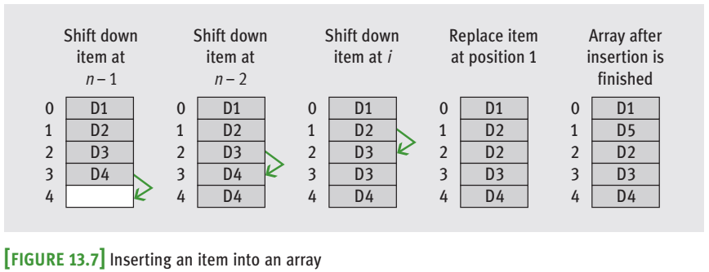

Slide 26
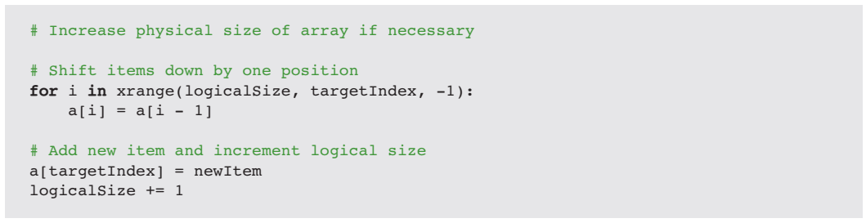

Slide 27
13.3.4 Removing an Item from an Array
In the case of a deletion, the programmer must do four things:
1 Shift the items from the target index position to the logical end of the array up by one. This process closes the hole left by the removed item at the target index.
2 Decrement the logical size by one.
3 Check for wasted space and decrease the physical size of the array, if necessary.

Slide 28
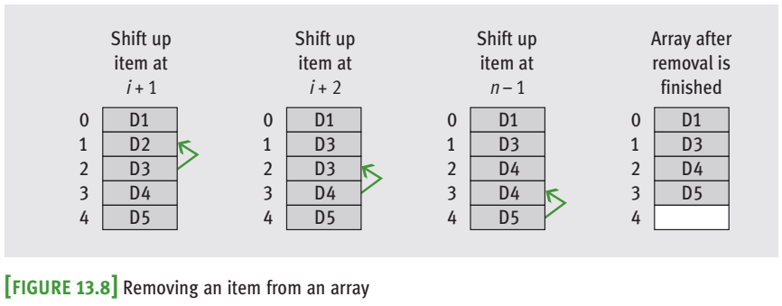

Slide 29
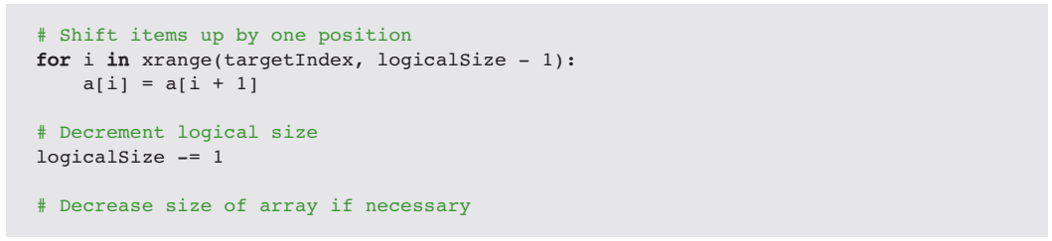

Slide 30
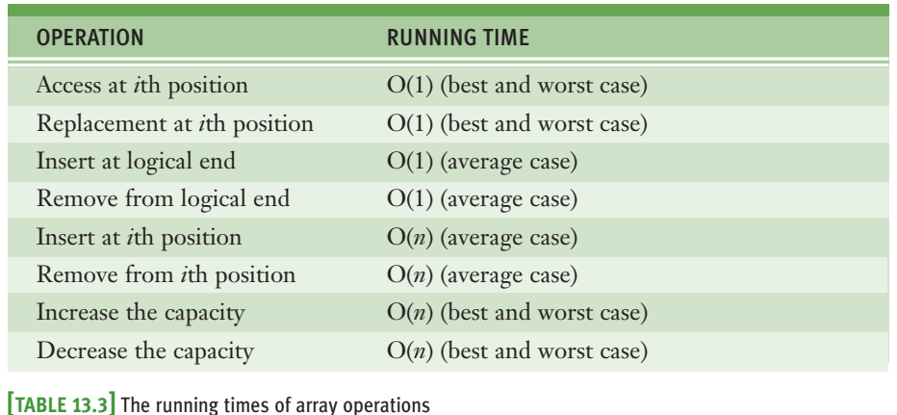
13.3.5 Complexity Trade-Off: Time, Space, and Arrays

Slide 31
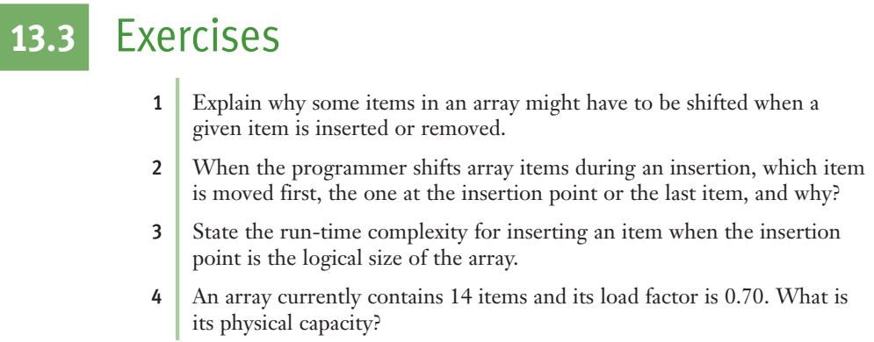

Slide 32
13.4 Two-Dimensional Arrays (Grids)

Slide 33
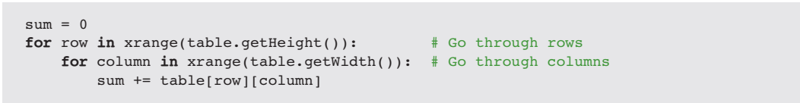
13.4.1 Processing a Grid
A grid must recognize two methods that return the number of rows and the number of columns.
These methods are named getHeight and getWidth, respectively

Slide 34
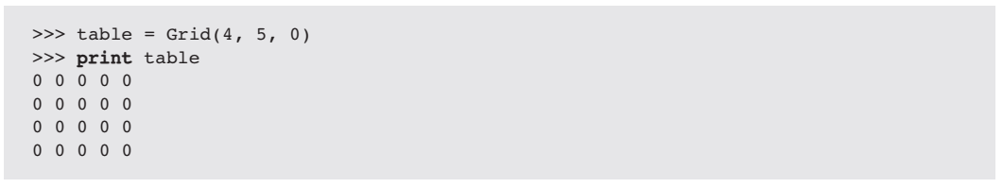

13.4.2 Creating and Initializing a Grid
Assume that there exists a Grid class for two-dimensional arrays.
To create a Grid object, we run the Grid constructor with three arguments: its height, its width, and an initial fill value.

Slide 35
13.4.3 Defining a Grid Class
A grid is conveniently represented using an array of arrays.
The length of the top-level array equals the number of rows in the grid.
Each cell in the top-level array is also an array.
The length of this array is the number of columns in the grid, and this array contains the data in a given row.

Slide 36
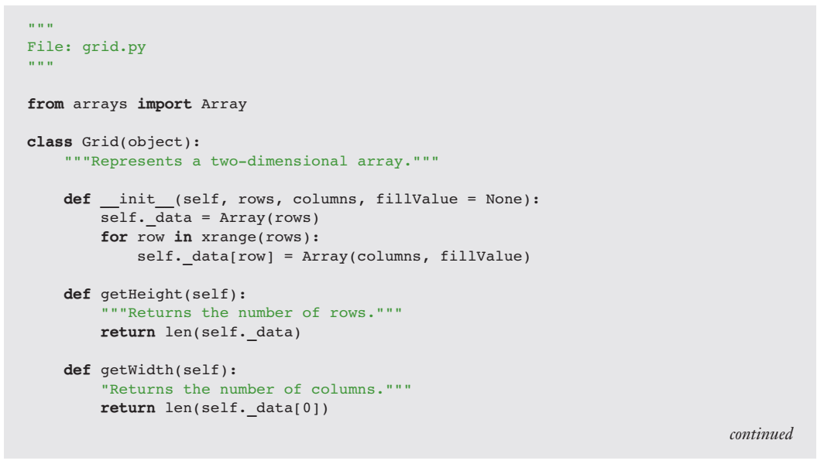

Slide 37
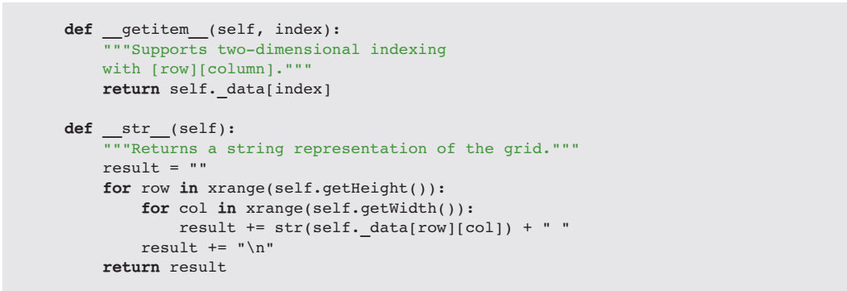

Slide 38
13.4.4 Ragged Grids and Multidimensional Arrays
It is also possible to create ragged grids and grids of more than two dimensions.
In a ragged grid, there are a fixed number of rows, but the number of columns of data in each row can vary.
Dimensions can also be added to the definition of a grid when necessary
3D array

Slide 39
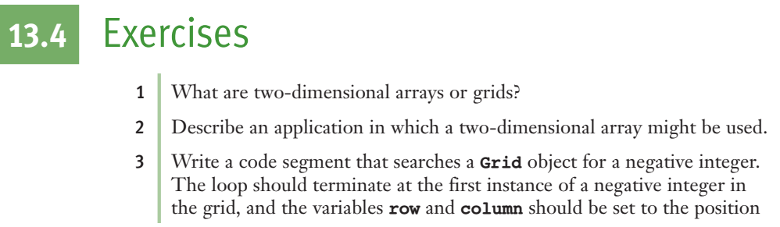

Slide 40
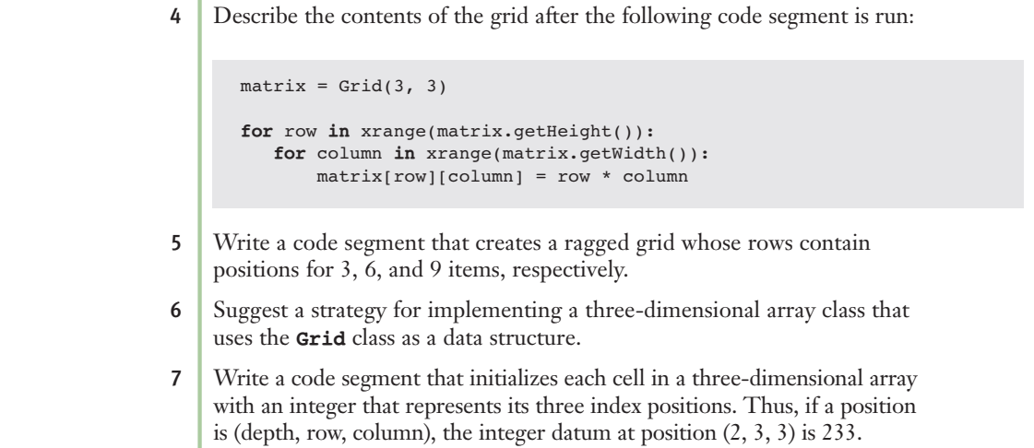

Slide 41
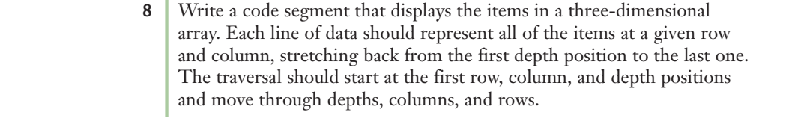

Slide 42
13.5 Linked Structures

Slide 43
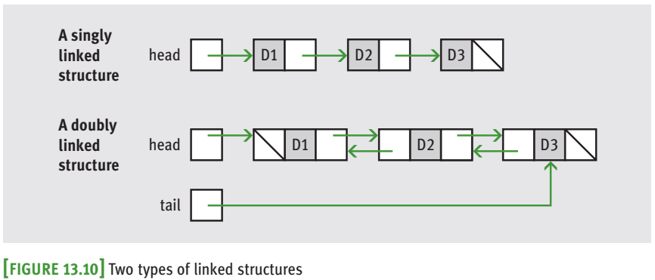
13.5.1 Singly Linked Structures and Doubly Linked Structures
A linked structure consists of items that are linked to other items.
The two simplest linked structures are the singly linked structure and the doubly linked structure

Slide 44
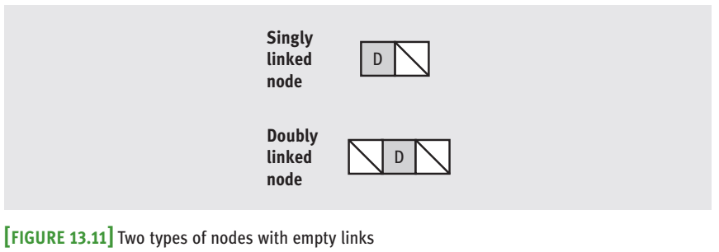
13.5.2 Noncontiguous Memory and Nodes
noncontiguous memory: the cell for a given item in a linked structure can be found anywhere in memory as long as the computer can follow a link to its address or location.

Slide 45
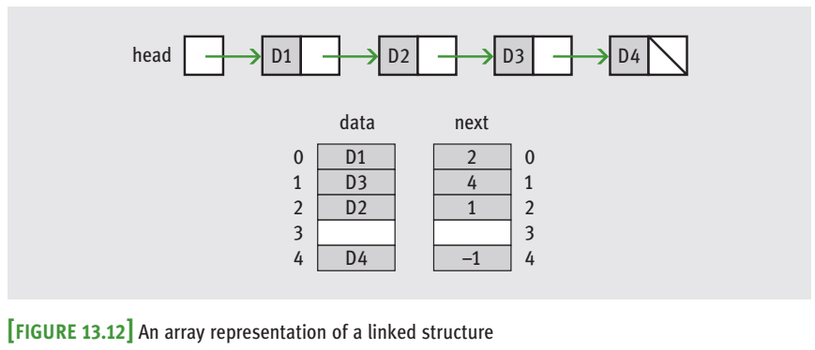
Non-continuous memory

Slide 46
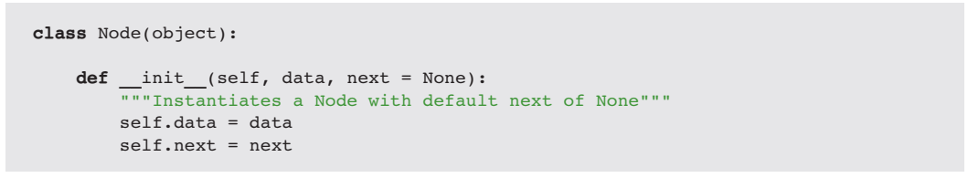
13.5.3 Defining a Singly Linked Node Class

Slide 47
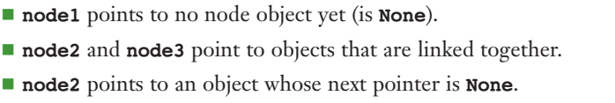
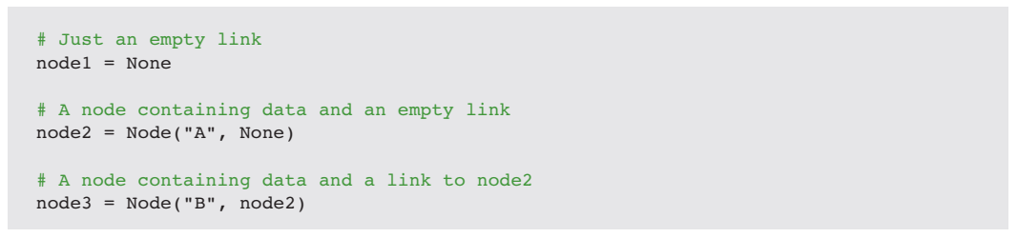
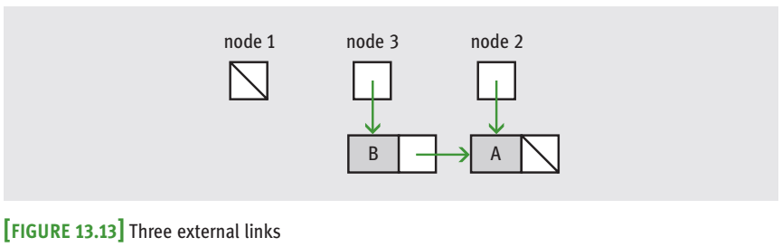
13.5.4 Using the Singly Linked Node Class

Slide 48
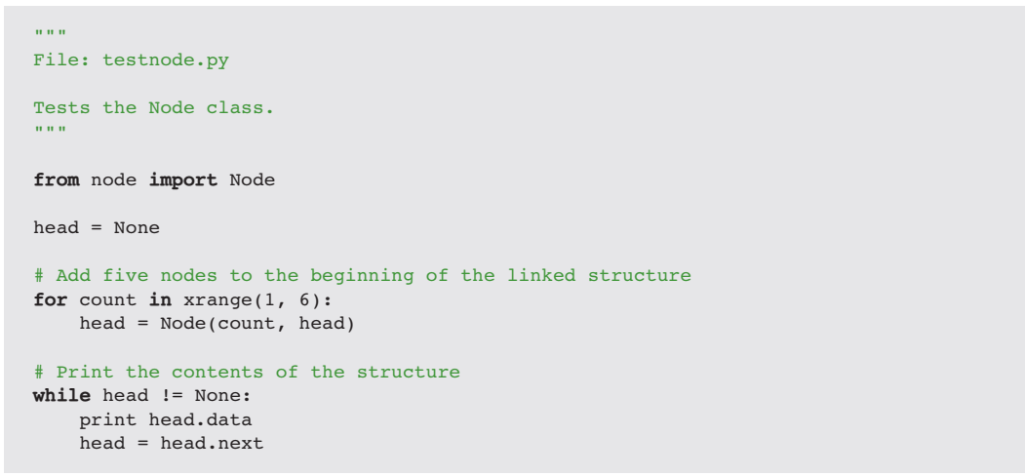

Slide 49
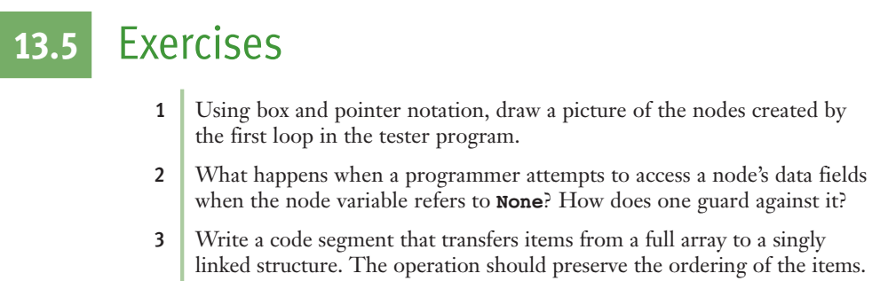

Slide 50
13.6 Operations on Singly Linked Structures

Slide 51
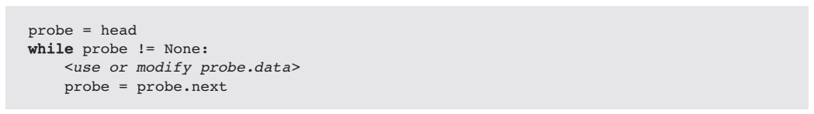
13.6.1 Traversal

Slide 52
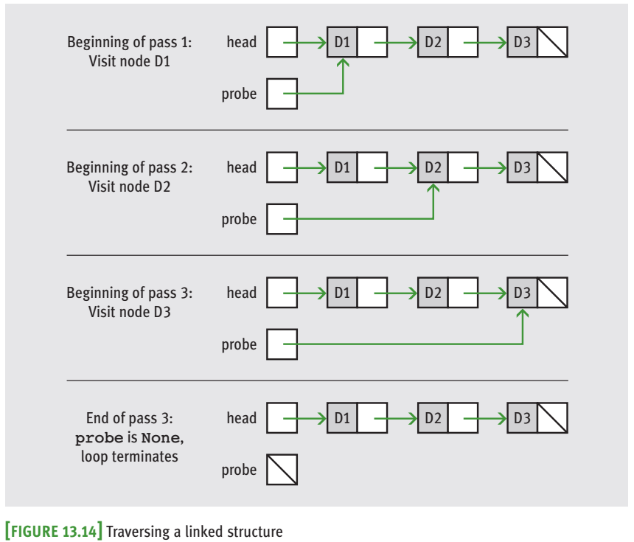

Slide 53
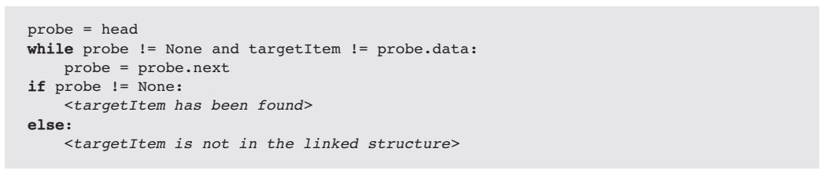
13.6.2 Searching
Search for a given item

Slide 54
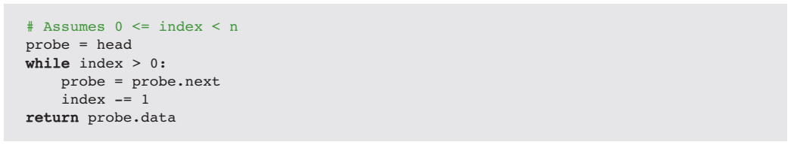
13.6.2 Searching
Accessing the ith item:

Slide 55
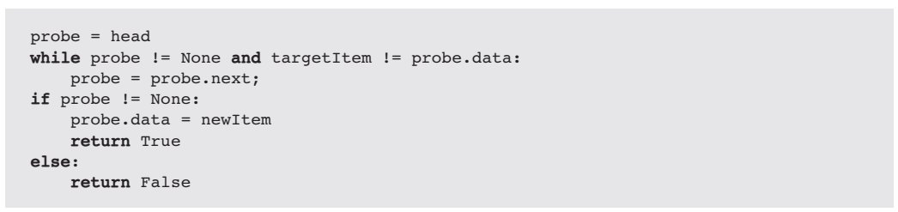
13.6.3 Replacement

Slide 56
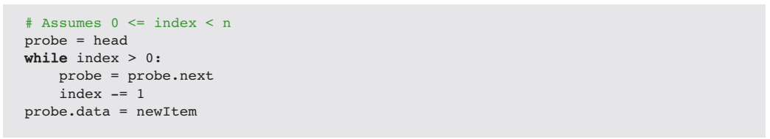

Slide 57
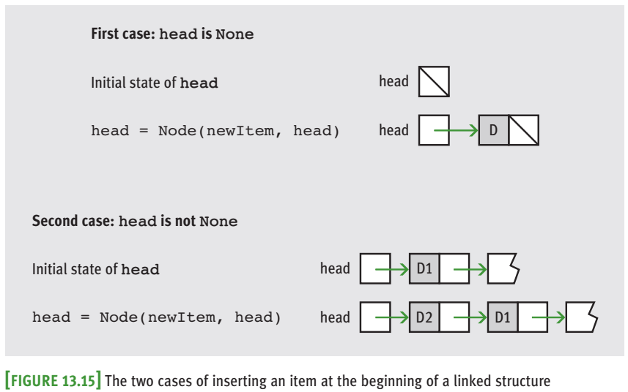
13.6.4 Inserting at the Beginning
Two cases:
Empty list ⬄ head is none
Non-empty list ⬄ head is not none.
Inserting data at the beginning of a linked structure uses constant time and memory.

Slide 58
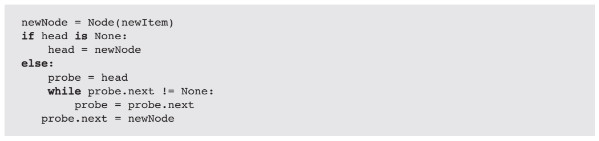
13.6.5 Inserting at the End
Two cases:
1 The head pointer is None, so the head pointer is set to the new node.
2 The head pointer is not None, so the code searches for the last node and aims its next pointer at the new node.

Slide 59
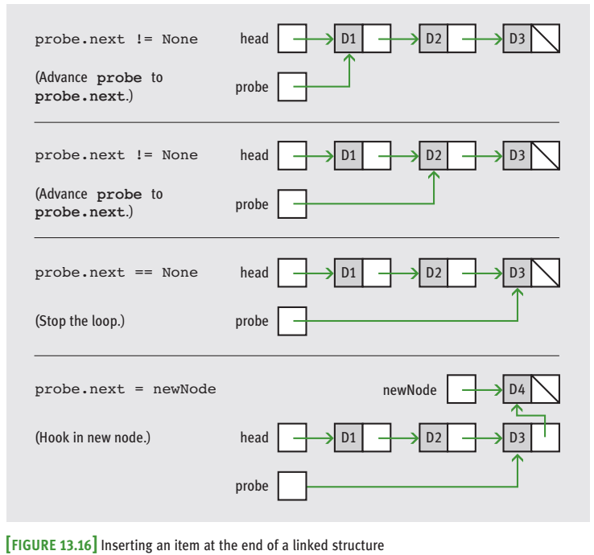

Slide 60
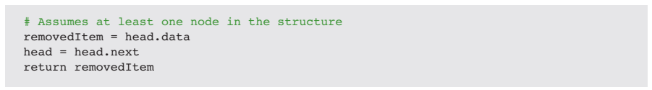
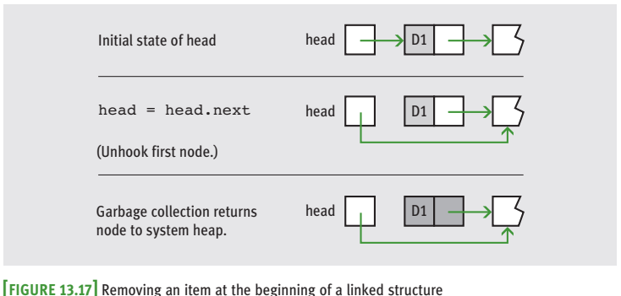
13.6.6 Removing at the Beginning
Update the pointer of the head.
the operation uses constant time and memory, unlike the same operation for arrays.

Slide 61
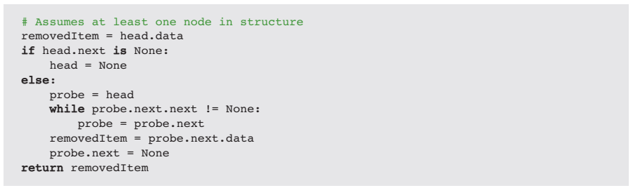
13.6.7 Removing at the End
Two cases to consider:
1 There is just one node. The head pointer is set to None.
2 There is a node before the last node. The code searches for this second-to-last node and sets its next pointer to None.
The operation is linear in time and constant in memory.

Slide 62
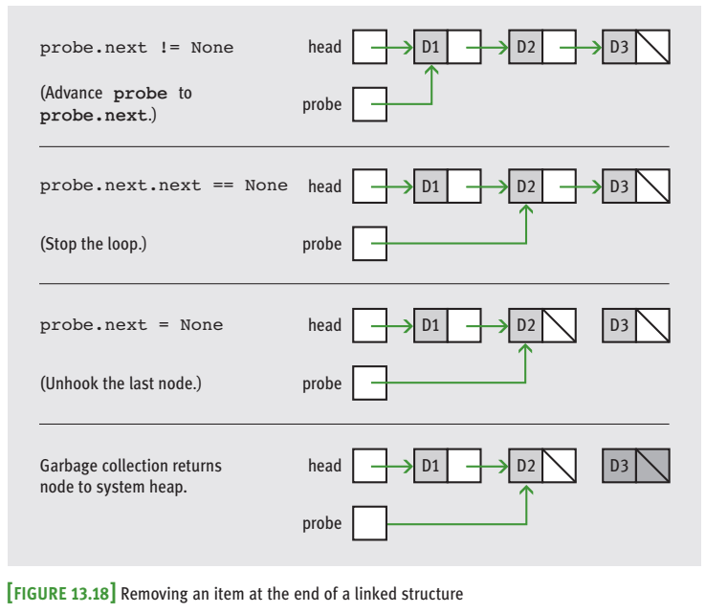

Slide 63
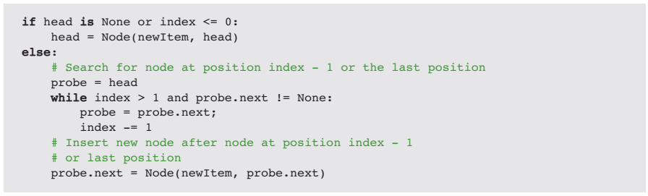
13.6.8 Inserting at Any Position
Insertion of an item at the i-th position - two cases to consider:
1 Node’s next pointer is None. This means that i >= n, so the new item should be placed at the end of the linked structure.
2 Node’s next pointer is not None. That means that 0 < i < n, so the new item must be placed between the node at position i - 1 and the node at position i.
O(n) time and O(1) memory

Slide 64
13.6.9 Removing at Any Position
The removal of the ith item from a linked structure has three cases:
1 i <= 0. We use the code to remove the first item.
2 0 < i < n. We search for the node at position i - 1, as in insertion, and remove the following node.
3 i >= n. We remove the last node.

Slide 65


Slide 66


Slide 67
13.7 Variations on a Link

Slide 68

13.7.1 A Circular Linked Structure with a Dummy Header Node
Circular linked structure with a dummy header node: a circular linked structure contains a link from the last node back to the first node in the structure. There is always at least one node in this implementation.
This node, the dummy header node, contains no data, but serves as a marker for the beginning and the end of the linked structure.

Slide 69


13.7.1 A Circular Linked Structure with a Dummy Header Node

Slide 70

13.7.2 Doubly Linked Structures
It allows the user to do the following:
1 Move left, to the previous node, from a given node.
2 Move immediately to the last node.

Slide 71

The Python implementation of a node class for doubly linked structures extends the Node class discussed earlier by adding a field for the previous pointer.

Slide 72

creates a doubly linked structure by adding items to the end.

Slide 73


Slide 74


Slide 75


Slide 76


Slide 77


Slide 78


Slide 79


Slide 80


Slide 81


